Slide 1

option
replay
start
quit

Slide 2
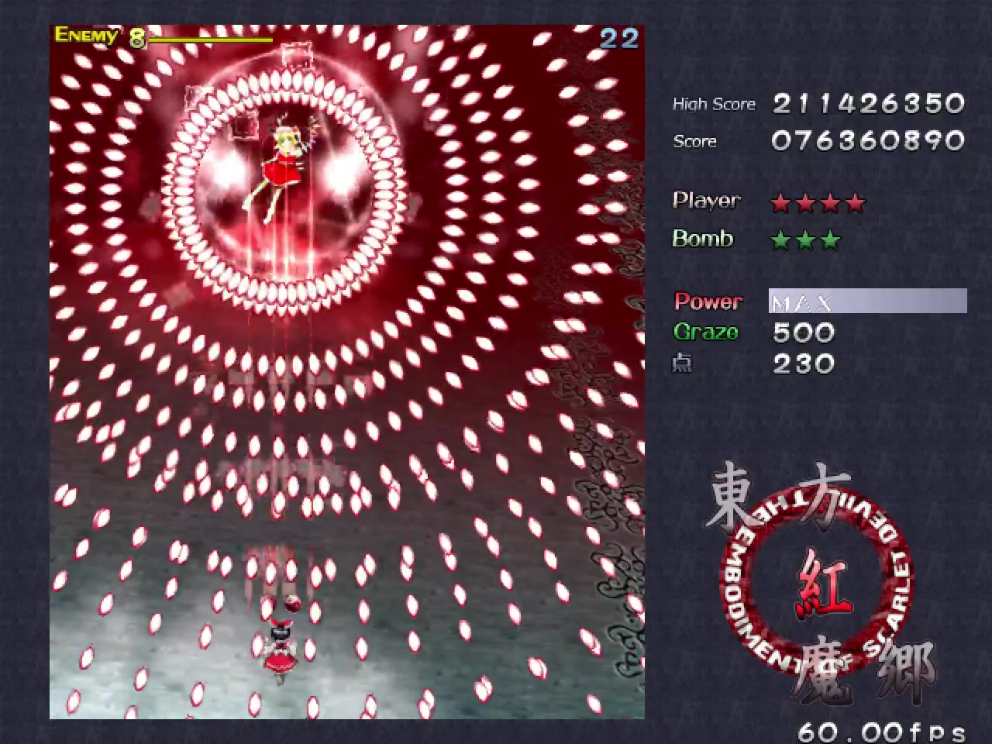
Recode : 00234537
Score : 0027365
Player :
score
score
score
score
score
score
Bomb :
score
score
score
score
MAX
300

